Slide 1
Early Entry Programs
Maryanne Maree-Sams
Director of Recruitment and Post-Baccalaureate Advising
Ellie Ivey
Graduate Enrollment Coordinator

Slide 2
Early Entry
Get a Jump Start on Your Graduate Education
In those programs offering this outstanding opportunity, undergraduate students get a head start on their graduate degree.
Exceptional undergraduate students attending UNC Charlotte can begin working toward their graduate degree before the completion of their baccalaureate degree.

Slide 3
Benefits
Early Entry students will have provisional acceptance to the graduate program, pending the award of the baccalaureate degree, and generally within two semesters.
Some early-entry programs are accelerated. Under this model, up to twelve hours earned at the graduate level may be substituted for required undergraduate hours. In other words, up to twelve hours of graduate work may be “double-counted” toward both the baccalaureate and graduate degrees. In no case may more than 12 hours be double-counted.
Early Entry students are charged undergraduate tuition and fees for all courses (graduate and undergraduate) for which they register. Upon completion of the baccalaureate degree, students are charged graduate tuition and fees. NOTE: Students in graduate programs that carry a tuition increment will be charged. However, this fee will be removed after the add/drop deadline.

Slide 4
Requirements
To be considered for Early Entry admission, a student must complete and submit an application and including supporting documents.
A student must submit an application for admission after completion of 75 or more hours of undergraduate course work, although it is expected that 90 hours of undergraduate coursework will have been earned by the time the first graduate course is taken.
A student must have at least a 3.2 overall GPA (on a 4.0 scale), but some programs require a higher GPA.
A given graduate program may have more rigorous admissions criteria.
If an early entry student has not met the normal admission requirements of a 3.0 GPA at the end of the baccalaureate degree, the student will be dismissed from the graduate program.

Slide 5
Requirements
Students accepted into an early entry program will be subject to the same policies that pertain to other matriculated graduate students.
Students are restricted to 15 credit hours of graduate level coursework prior to the completion of the baccalaureate degree.
No courses taken before admission to the graduate program may be applied to a graduate degree.
Students must be enrolled at UNC Charlotte.

Slide 6
Requirements
Once admitted, a student must complete the graduate academic petition and have it approved by the Graduate Program Director and undergraduate advisor before registering for any graduate level course.
Note: a given graduate program may have more rigorous admissions criteria
If an early entry student has not me the normal admission requirements of a 3.0 by the end of his/her baccalaureate degree, they will be dismissed from the graduate program. Students accepted into an early entry graduate program will be subject to the same policies that pertain to other matriculated Graduate Students. Generally, it will be assumed that early entry students will finish their baccalaureate degrees before they complete 15 hours of graduate work.
Students must be enrolled at UNC Charlotte.

Slide 7
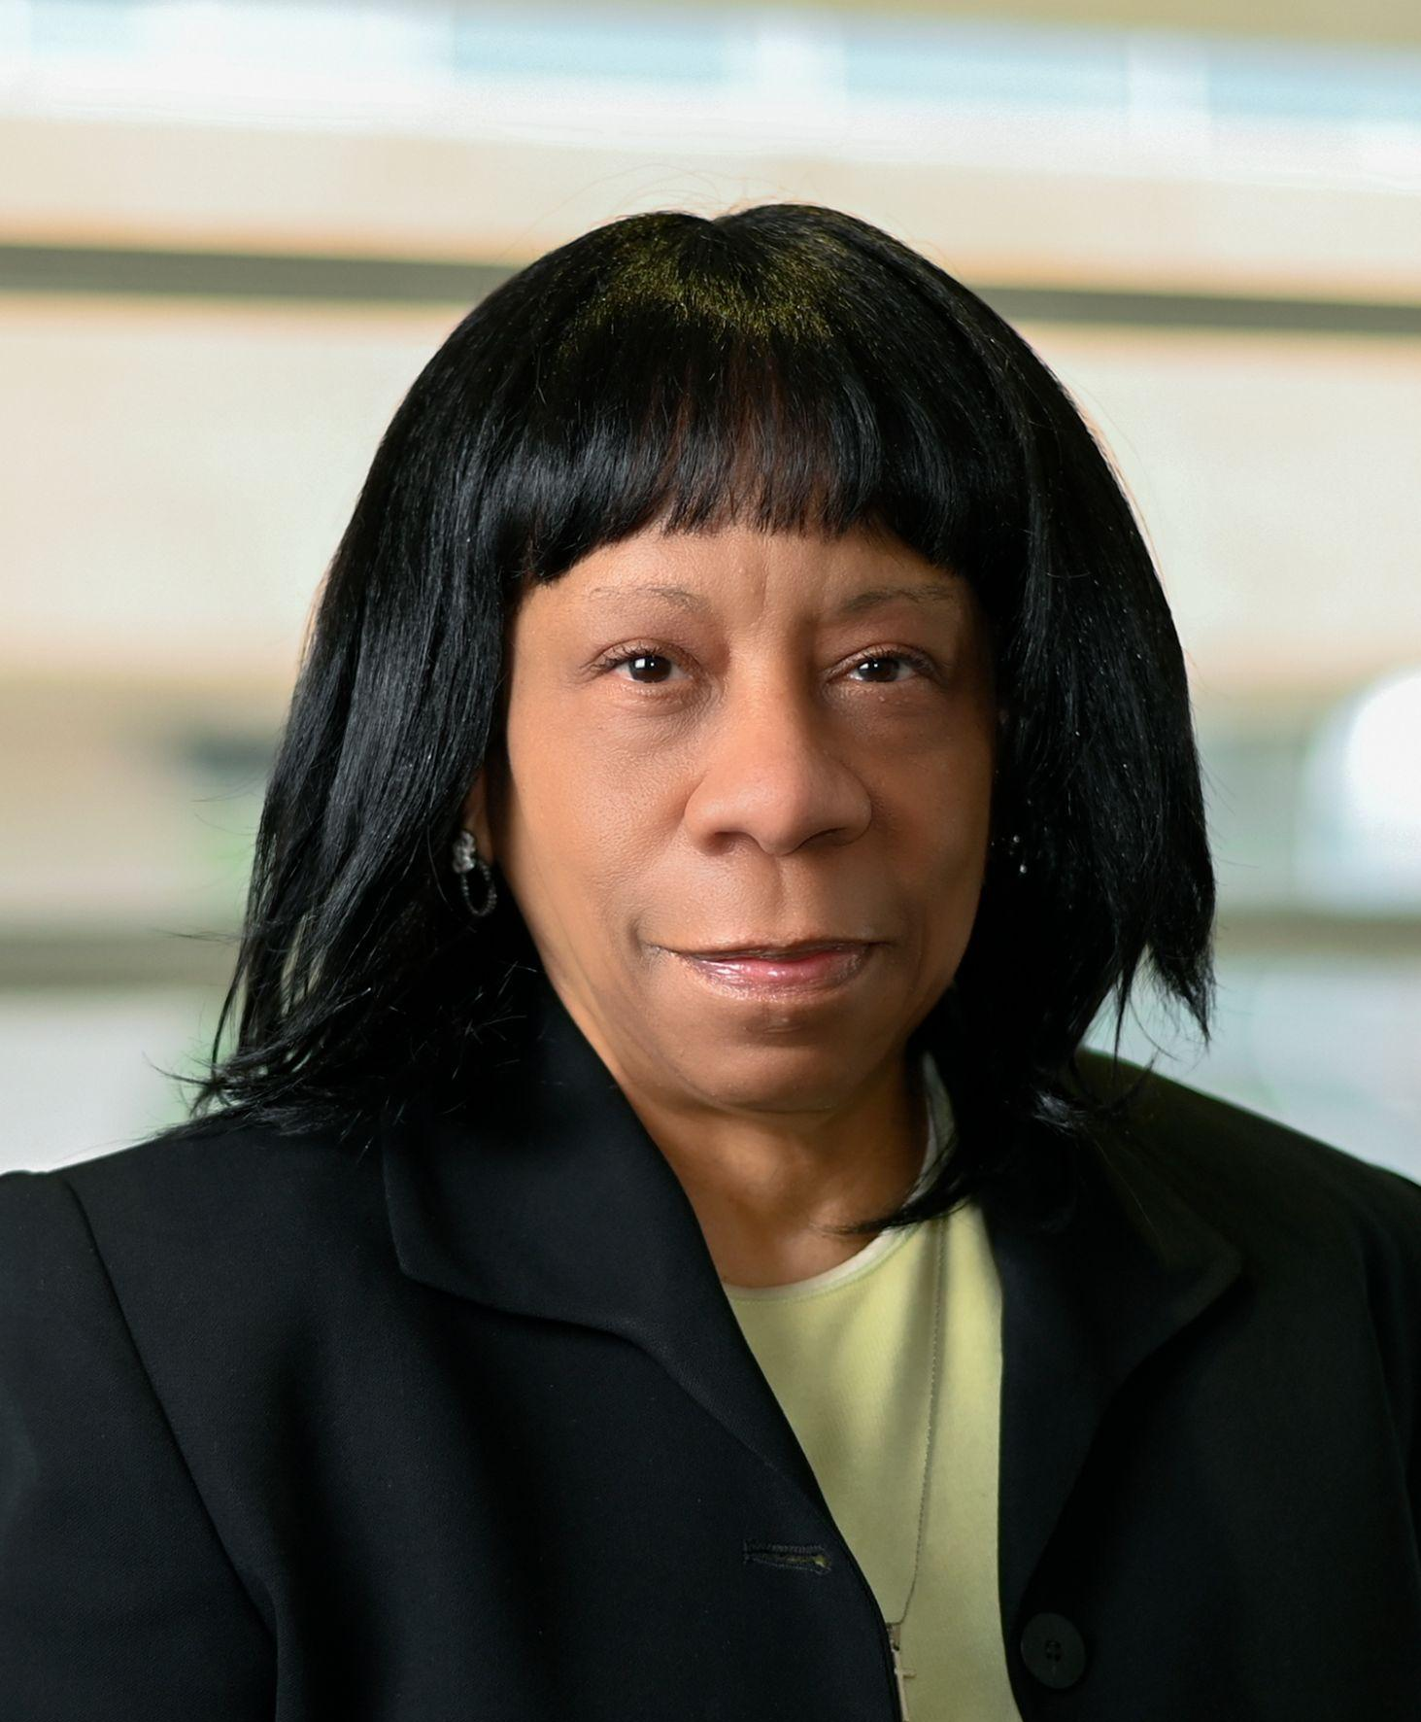
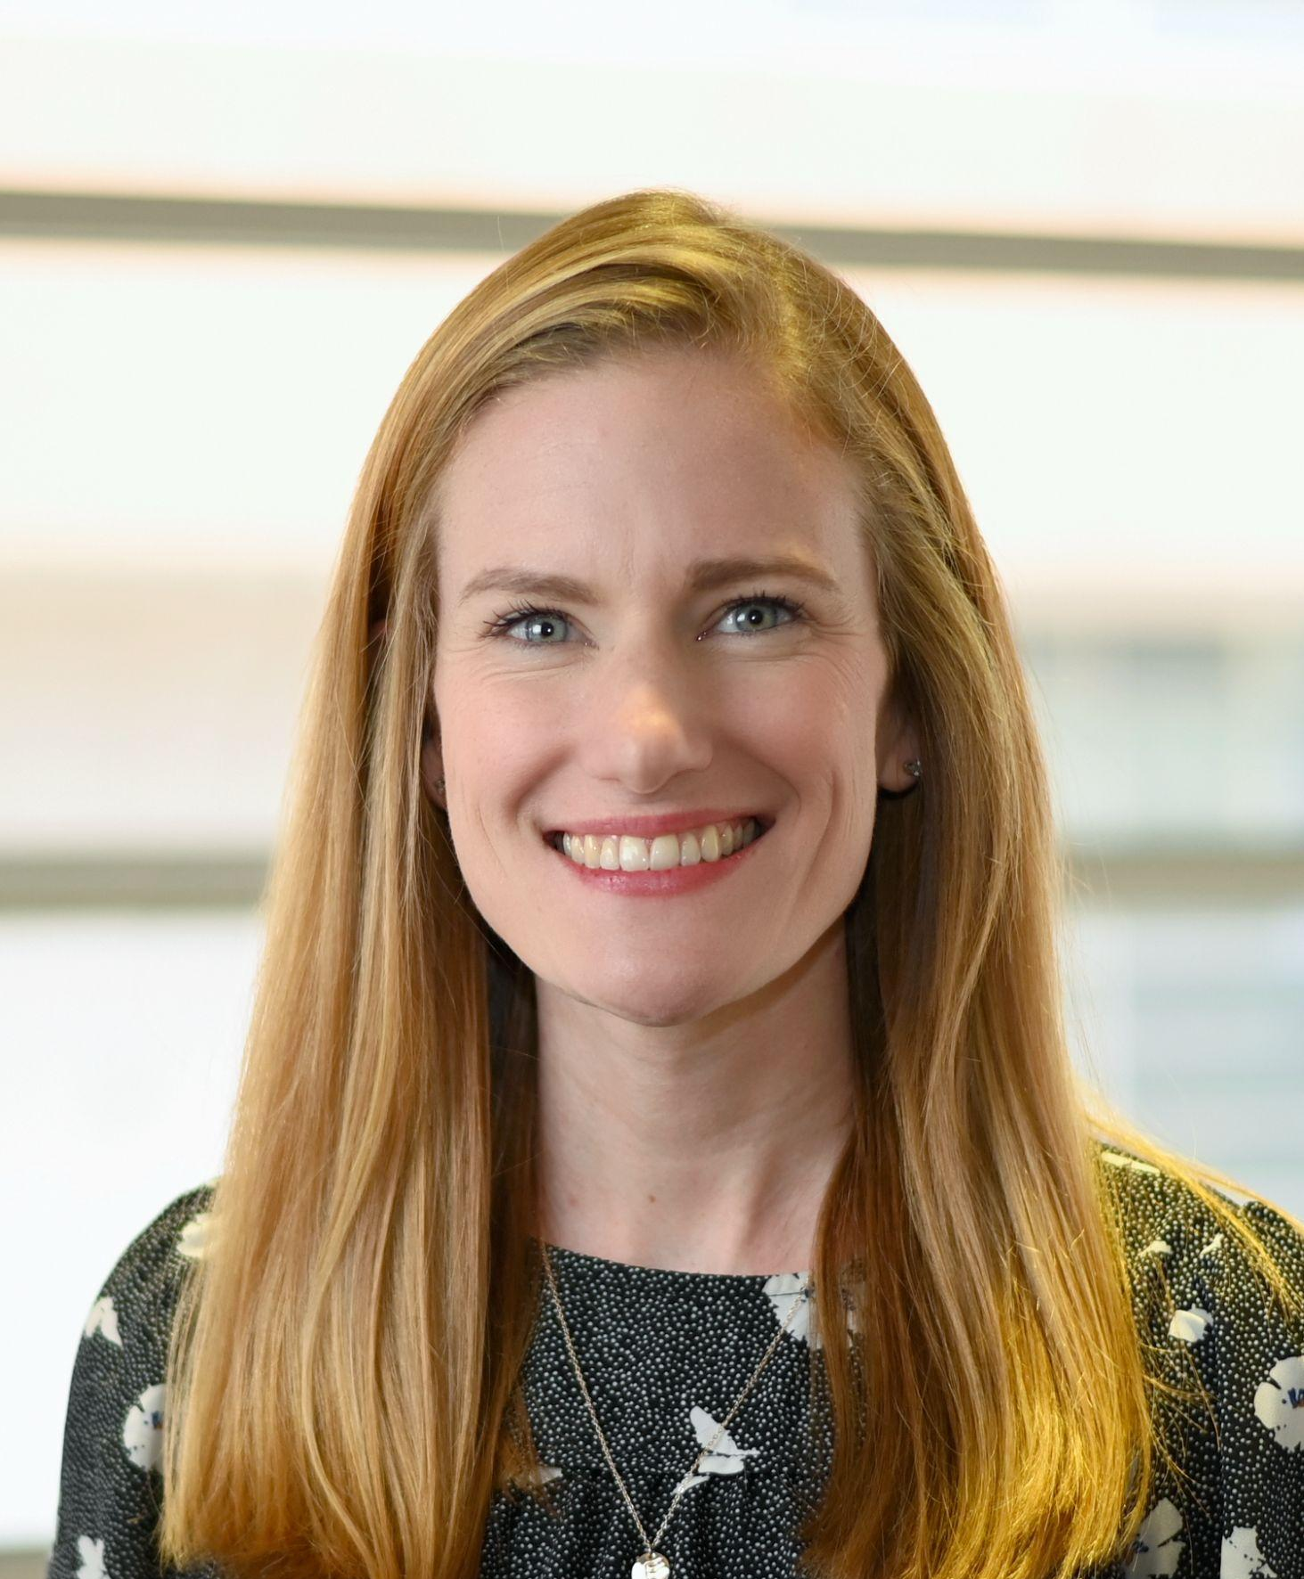
UNC Charlotte Graduate Admissions
Graduate Admissions Counselors:
Maryanne Maree-Sams Director of Graduate Recruitment & Post-Baccalaureate Student Advising
Ellie Ivey
Graduate Enrollment Coordinator

