Slide 2
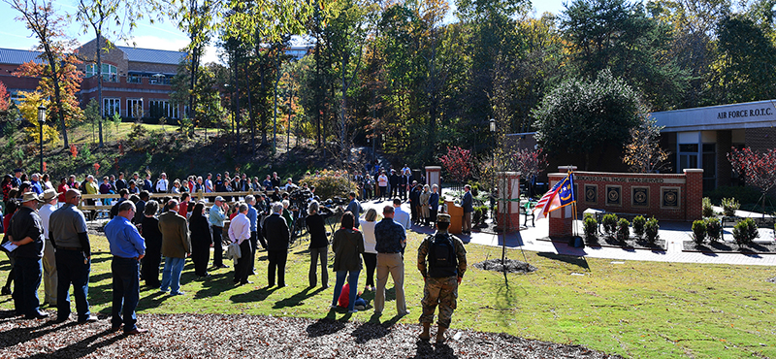
VETERAN AFFILIATED STUDENTS TRANSITIONING TO HIGHER EDUCATION
Veteran Services Office
Barnard 103

Slide 3
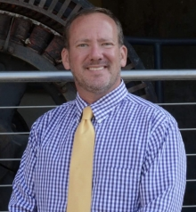
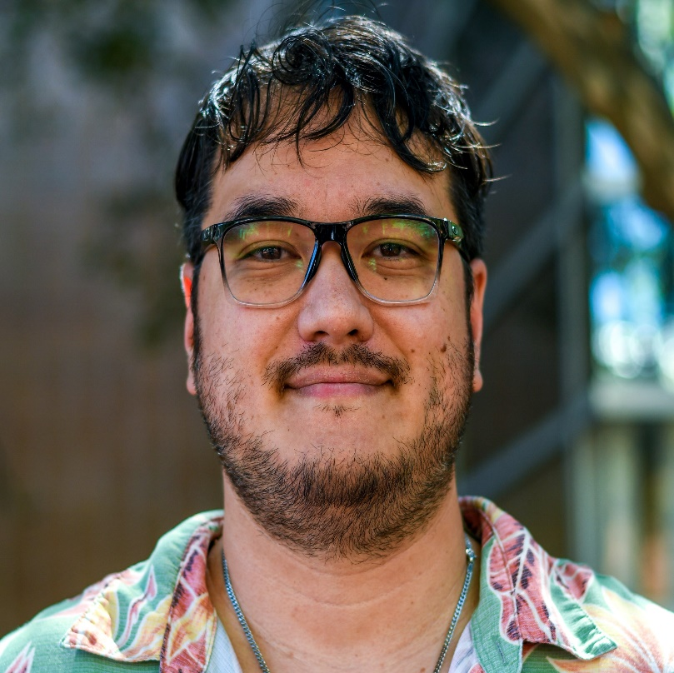
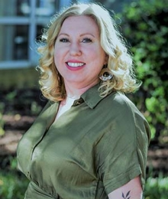
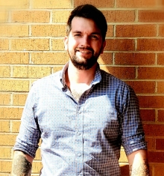
VETERAN SERVICES OFFICE STAFF
Director of Veteran Services
Bill Wilson
Lead VA Certifying Official
Chris Brasel, USN
Certifying Official
Sara King, USN
Program Manager
Tyler Thomas, USA
Veteran Services Office
Barnard 103

Slide 4
CHARLOTTE VETERAN SERVICES OFFICE STAFF
Nearly 1,200 students using Veteran Affairs Educational Benefits
Director of Veteran Services
2 School Certifying Officials
Program Manager for VSO
2 Graduate Assistants
10 VA work study students
Military Affairs Committee (campus)
Military Affairs Working Group (system)
Veteran Services Office
Barnard 103

Slide 5
STUDENT POPULATION OF THE VSO
Military Affiliated Students
• Veteran students
• National Guard/Reservists.
• Dependents. Spouses or children, these are connected to a veteran sponsor
• Active Duty
Veteran Services Office
Barnard 103

Slide 6
STUDENT POPULATION OF THE VSO
Military Affiliated Students
Our office uses the term “military affiliated” to highlight the fact that over 50% of our student population is now dependent students vs veterans. Dependent students do not have access to all VA educational benefits but can use transferred Post 9/11 GI Bill or Dependent Education Assistance which is tied to the sponsor’s VA disability rating. This student population is growing in size.
Veteran Services Office
Barnard 103

Slide 7
VA EDUCATIONAL BENEFITS
Main purpose of the office is to certify VA educational benefits.
• Process Montgomery, Post 9/11 GI Bill
• Veteran Readiness and Employment
• Reserve/National Guard 1606 benefit
• Dependent’s benefit
• Tuition Assistance for Active Duty.
Veteran Services Office
Barnard 103

Slide 8
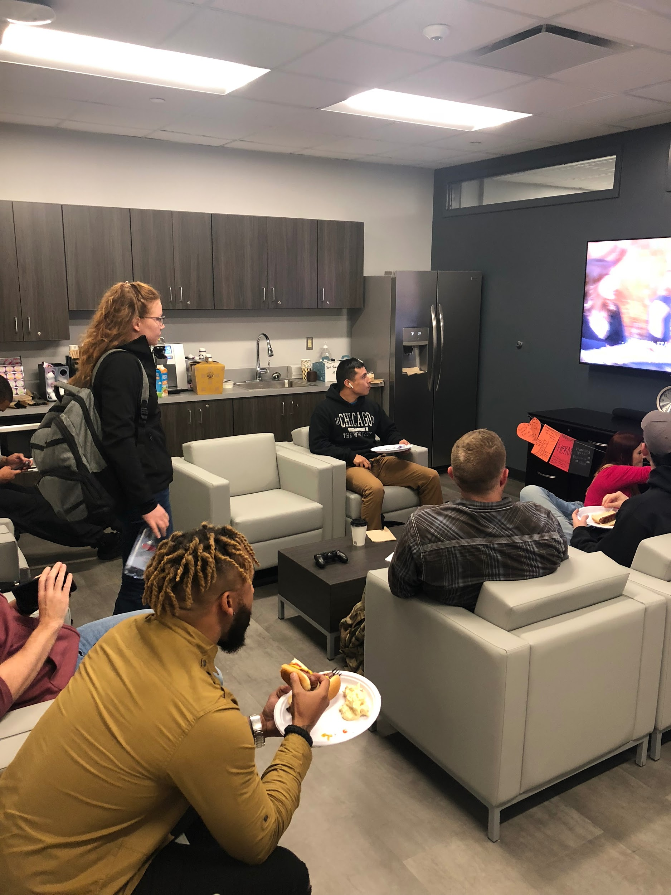
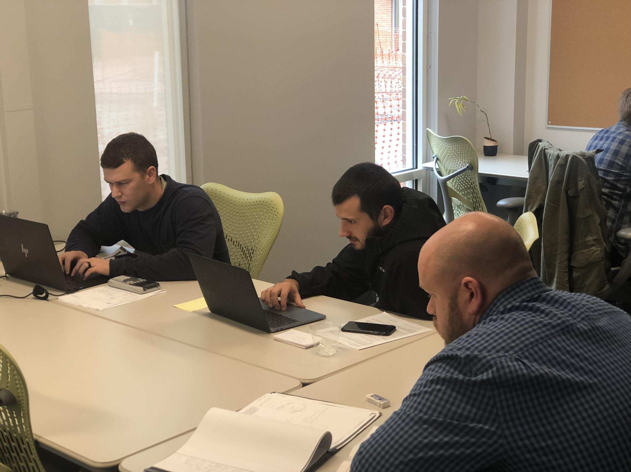
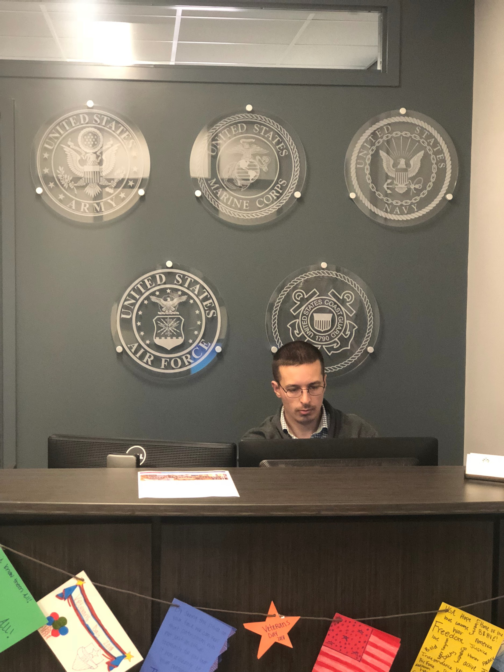
CONNECTING TO STUDENTS
STUDY/ LOUNGE LOCATION
• Lounge has free coffee/water /refrigerator
• Space for studying/collaborative study space
• Lounge space with television including a gaming system
• Meeting location for student veterans
• A place to connect with your fellow veterans
Veteran Services Office
Barnard 103

Slide 9
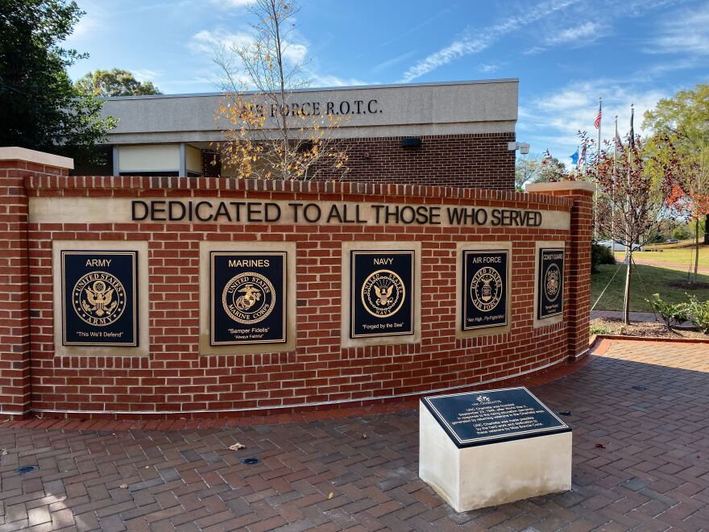
VSO RESOURCES
CAMPUS RESOURCES
Provide professional outreach within the community such as hiring conference, network luncheons, and educational classes
Weekly counseling session held in the lounge (facilitated by CAPS)
Workshops: OASES (advising), UCAE (study skills), and many others
PAVE (Peer Advisors for Veteran Education)
VA Work Study positions (work while on campus)
Student Veterans Association (UNCC chapter of SVA)
Veteran Services Office
Barnard 103

Slide 10
CHALLENGES FACED
• Time away from the classroom.
• Age difference with “traditional” undergrad/grad students
• Jargon (veteran terms)
• Slang (popular culture/hidden curriculum)
• Family responsibilities. Many have priorities outside of campus.
• Commuter students
• Jobs. VA educational benefits only go so far.
• Disconnect from campus community
• Residency issues (can be covered by VSO)
• Military credit (Registrar’s office has been great recently)
Veteran Services Office
Barnard 103

Slide 11
STIGMA: PTSD AND TBI
ACADEMIC PERFORMANCE
CHALLENGES ASSOCIATED
• Attention and concentration difficulty
• Information processing challenges
• Sluggish or abstract thinking
• Learning and memory deficits
• Slowed functions-problem solving, awareness, sequencing.
• Sleep disturbances
• Panic attacks
• Financial stress
• Home life stress
• Transition to civilian life
Veteran Services Office
Barnard 103

Slide 12
WHAT YOU CAN DO
• Treat like any other student. Not all veteran students want to be treated differently.
• Avoid assumptions, military services has changed and their experiences vary.
• Have patience.
• Problems in the classroom? Talk to them directly! Most veteran students like direct feedback.
• Consider their experience, both service connected and age.
• Curriculum: Politics, war, conflict zone discussions.
Veteran Services Office
Barnard 103

