Slide 1
Enrollment is Everyone’s Business!

Slide 2
Recruitment Refreshers and Discussion

Slide 3
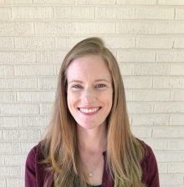
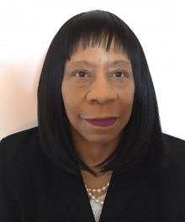
Recruitment Team
Maryanne Maree-Sams, Director of Recruitment and Post-Baccalaureate Advising
Ellie Ivey, Graduate Enrollment Coordinator
Sarah Hastings, Student in the M.A. in Counseling Program
Kelly Duong, Student in the M.A. in Counseling Program

Slide 4
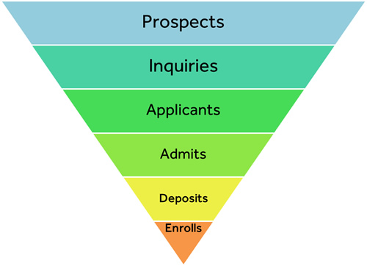
Action Items
RECRUIT: Feed the admissions funnel with quality prospects and inquiries
INFORM: Give prospective students and applicants relevant information in a timely manner
CONNECT: Increase yield at every phase of the recruitment funnel
Specifically the admit to enroll**

Slide 5
**Fall 2022: Accept to Enroll Yield

Slide 6
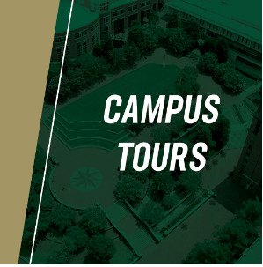
Graduate Admissions: Recruit
Slate Communication Campaigns
Currently running: Yield and Anti-Melt Campaigns (email, text, calls, print)
Marketing team is updating these on the communication flow spreadsheet (posted in GPD Net)
Campus Tours
Tours are offered every Tuesday at 10am and by appointment
Special tours are offered for groups (TRIO, schools, organizations, etc.)
Recruitment Events/Opportunities
National Name Exchange
GradSchoolMatch
Fairs (list of local, national and international events)

Slide 7
Graduate Admissions: Inform
Information Sessions (Virtual and In person)
Provides a general overview of programs, admissions requirements, the application process including standardized test requirements, funding opportunities, and financial aid
Specific sessions for Early Entry, Faculty/Staff, specialized groups, and individual programs
Individual Appointments
Online and in person, 1:1 appointments with admissions counselors
Office Hours
Bi-weekly virtual office hours for prospective students to ask questions about topics of interest

Slide 8
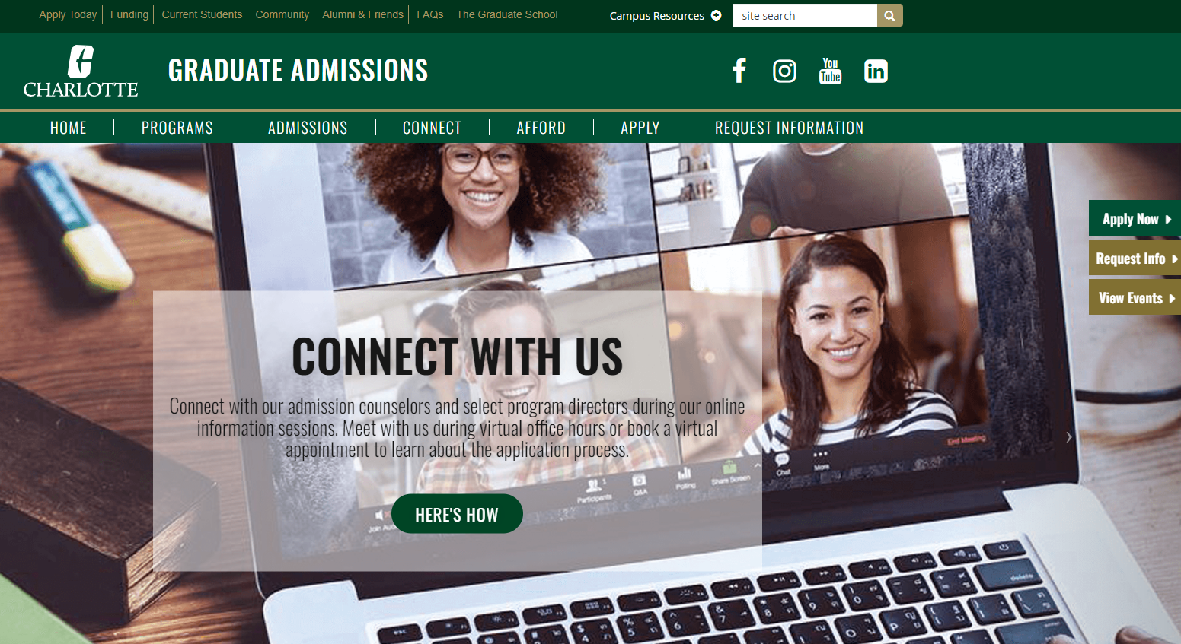

Slide 9
Graduate Admissions: Connect
Targeted Outreach - Over 1000 outbound calls to date this semester
Graduate student workers calland encourage prospective students to submit the application, complete the application, and confirm their intent to enroll
Admissions Ambassadors
Graduate Admissions Ambassadors interact with prospective and admitted students to help answer questions about the university and encourage them to enroll
Admitted Student Information Sessions
Designed specifically to engage admitted students and share information to help them choose UNC Charlotte

Slide 10
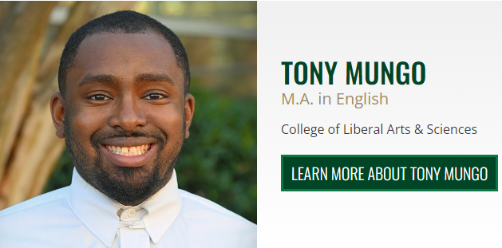
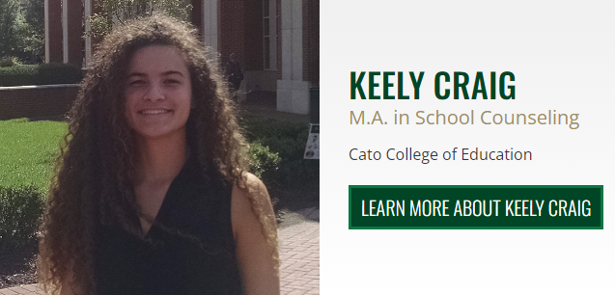
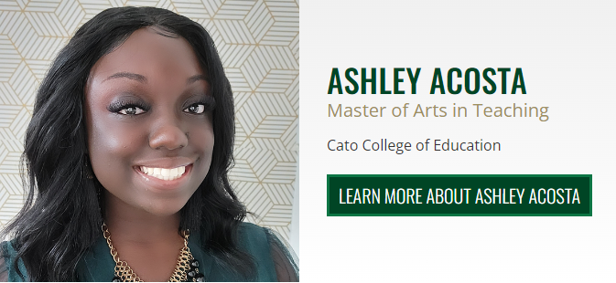
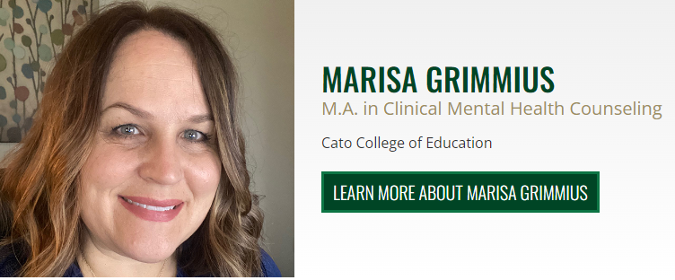
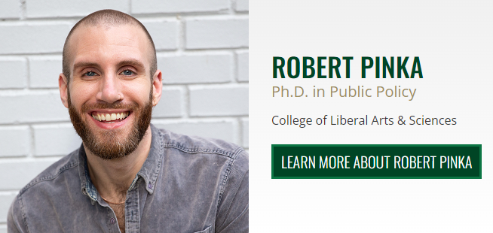
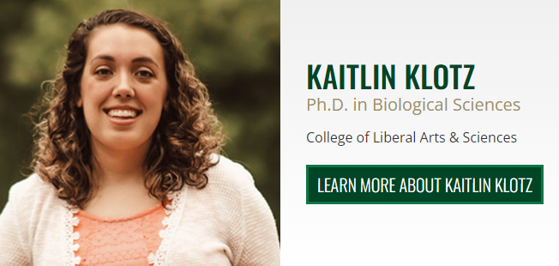
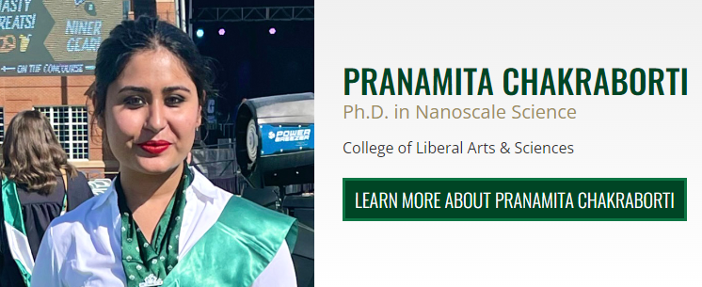
Graduate Admissions Ambassadors

Slide 11
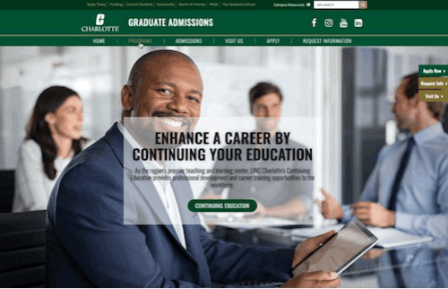
Top 5 Things You Can Do! (At a minimum….)
Update the program website:
GPD/Coordinator contact Information
Application deadlines
Delivery method (in person/online/hybrid
Plan of study/when are courses offered
Career outcomes
Funding information

Slide 12
Top 5 Things You Can Do (cont’d.)
2. Communicate with prospective students (virtually and in person)
Respond to inquiries in a timely manner
Engage faculty and current students in the recruitment and retention efforts
Recruit UNC Charlotte undergraduate students (especially if your program offers early entry admission!) and alumni
Participate in monthly information sessions with Graduate Admissions; better yet, work with them to schedule a program-specific recruitment event
3. Make decisions on Ready for Review applications in a timely manner
If your program does not review on a rolling basis, post the review and decision timelines on your website (Example: M.A. in Counseling)

Slide 13
Top 5 Things You Can Do (cont’d.)
4. Connect with newly admitted students
Encourage admitted students to confirm their intent to enroll and register
Host an admitted student event (it can be virtual or in person!)
Contact returning students who are eligible to register (list sent from Graduate Admissions)
5. Engage with continuing students (retention!)
Encourage advisors to communicate with students at regular times throughout the semester
Host activities to engage students and create strong student connections
Contact returning students who are eligible to register (list sent from Graduate Admissions)

Slide 14
Discussion and Questions
What is your program doing to recruit new students and retain continuing students?
Is your program experiencing particular enrollment challenges?
How can Graduate Admissions help?

Slide 15
Resources
GPDNet
Graduate School Website: Faculty and Staff Resources
Fact Book:
Admissions Trends and Yields
Enrollment Data
Retention-Graduation Data

