Slide 1
GPD Summit
February 4th, 2022

Slide 2
Welcome and Introductions
Notes:
TOM

Slide 3
Graduate Council Update
Notes:
DAVID

Slide 4
Student Lifecycle Resources
Notes:
JOHNNA

Slide 5
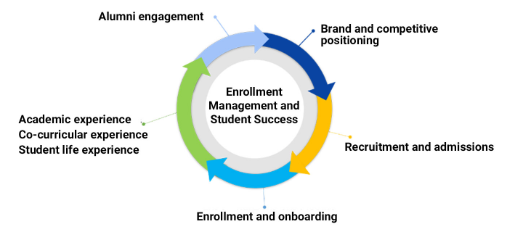
GPDNet: News, Info, GPD Resources
Spring 2022 GPD Resources and Information

Slide 6
Updates and reminders in written form
https://docs.google.com/document/d/1fs60je3jBqyD49oa0L2yC81EavzZcgjEpSS8fXDxdyw/edit?usp=sharing

Slide 7
Graduate Student Mental Health
Paula M. Keeton, Ph.D.
Director
02/04/2022
Notes:
Katherine introduces Paula

Slide 10
Given those snapshots . . .
•We know that graduate students are struggling more now than pre-pandemic, mostly due to the list on the previous screen
•What can you do to help?
•When in doubt whether someone needs help, ask the person you’re concerned about or seek consultation (asking someone about their challenges doesn’t make them worse; it could actually help them feel better)
•Utilizing good listening skills is critical
•Know your campus resources (CAPS, Student Health, Wellness Promotion, Care and Assistance, etc….)
•Consider getting training for yourself in helping skills, collegiate mental health, and/or suicide prevention

Slide 11
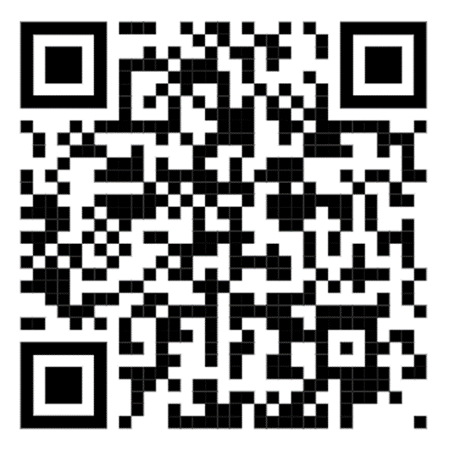
Cultivating a Community of Care
Learn About QPR & Mental Health First Aid:

Slide 13
Best Practice Moment: Onboarding Toolkit
Notes:
JILL

Slide 14
Authorship Agreements
Notes:
Jill introduces Lisa

Slide 15
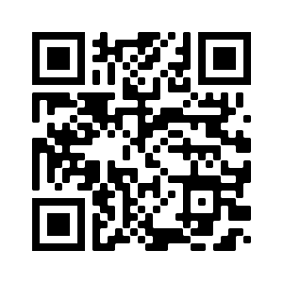
Authorship Policy and Resolution Procedures
University Policy 318
https://legal.charlotte.edu/policies/up-318

Slide 16
Background:
Centrality of authorship in academia
+ Vulnerability
+ Lack of universal standards
= need for clear guidance
Charlotte pilot survey indicated:
47% of trainees/43% of faculty have experienced problems with authorship order
27% of trainees/32% of faculty have experienced wrongful author inclusion (guest authorship)
26% of trainees/28% of faculty have experienced wrongful author exclusion
Larger survey indicated:
44% of graduate students and 30% of faculty agree or strongly agree that they have “concerns about the lack of guidance for authorship distribution.”

Slide 17
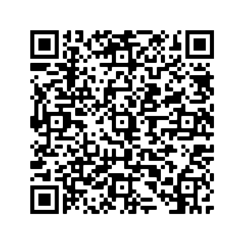
Policy Purpose: Recommend constructive authorship practices and establish standards for resolving authorship disputes
Policy Features:
Sets minimum authorship requirements (substantial contribution to the work and accountability for one’s work)
Does not provide a single set of authorship standards
Assigns responsibility for discussing authorship to:
Lead Author, Corresponding Author, or Principal Investigator
Recommends discussing authorship early and often during a project
Recommends completion of an authorship agreement
Charlotte Authorship Agreement

Slide 18
Dispute Resolution Procedures:
Informal: consult written agreement; involve neutral 3rd party (e.g., Chair); work with Ombuds Office, etc.
Formal:
Written initiation with Graduate Dean
If Dean determines there is merit, appoints a 3-member Authorship Dispute Panel
Members are tenured faculty; 1 graduate student member if dispute involves a graduate student
Panel makes written recommendation to Dean
Not binding, but if a disputant does not agree with recommendations, Dean may share panel recommendations with a disputant’s administrator.

Slide 19
Communications and Marketing Update
Notes:
Lisa hands off to Sam

Slide 20
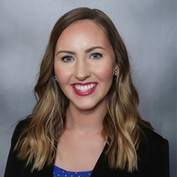
New Hire on Enrollment Management Team
Sam Finley, Director of Marketing & Communications
Notes:
Johnna Introduces: Sam Finley is the Director of Marketing & Communications for the UNC Charlotte Graduate School, where she supports the University’s portfolio of over 170 graduate programs of study. Sam received her B.A. in Organizational and Professional Communications from the University of Wisconsin-La Crosse, and brings significant experience in marketing automation/CRM administration, integrated enrollment marketing, strategic communications and engagement, media planning, social media, and branding experience to the Graduate School team. Over the last four years, Sam served as the Marketing & Communications Manager for the UNC Charlotte Belk College of Business. Previously, she was the Marketing Director for Program Experience at the YMCA of Greater Charlotte.

Slide 21
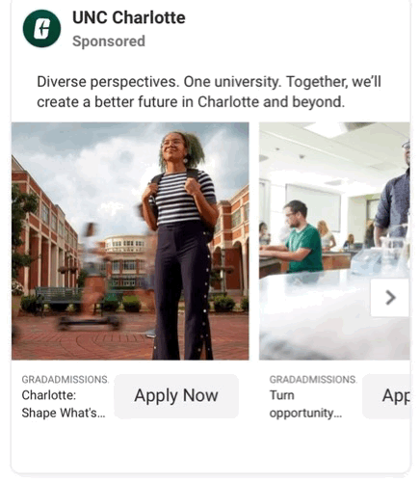
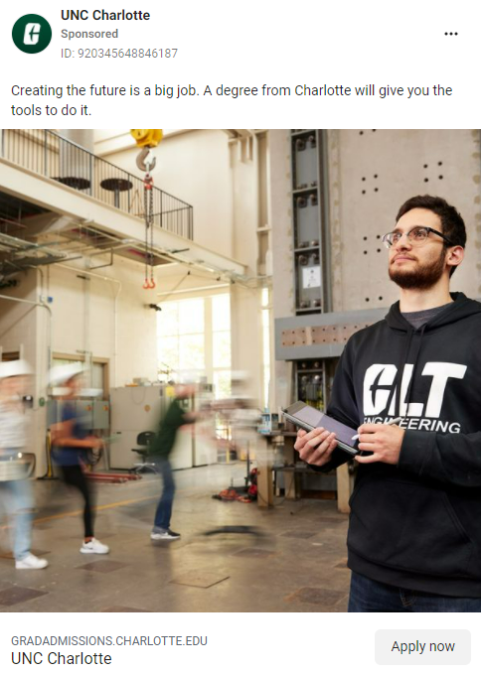
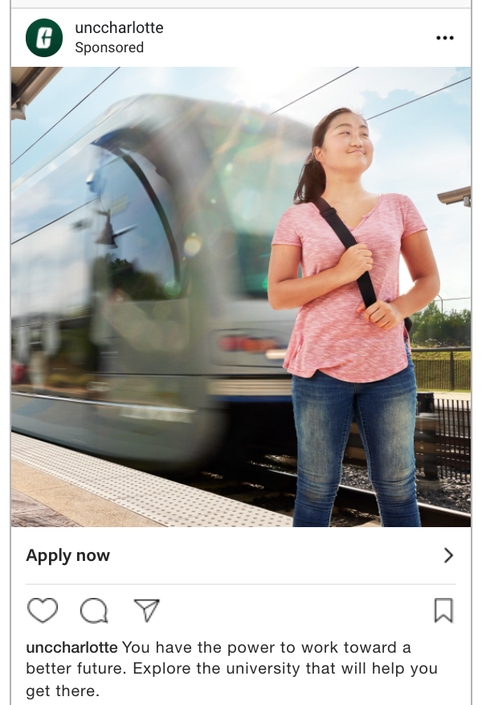
‘Shaping What’s Next’ - Spring Paid Media Campaign
Media Flight
End of January-May
Target
Geography: Charlotte DMA, North Carolina and select Virginia counties
Graduate Demo: Prospective graduate students (average age of 31), part- or full-time
Landing Page
https://gradadmissions.charlotte.edu
Reminder to confirm info on program pages → Update via GPDNet Program Dashboard
Notes:
Sam overviews the campaign

Slide 22
Graduate Student Achievement Metrics
Notes:
Sam to Johnna

Slide 23
December 2021: SACSCOC updated its policy on “Institutional Obligations for Public Disclosure” which is one of the standards on which the University must submit documentation. It states:
A candidate or accredited SACSCOC institution is obligated to provide information to its students, constituents, and the public about itself that is complete, accurate, timely, accessible, clear, and sufficient.
The institution has readily available valid documentation for any statements and promises regarding such matters as program excellence, learning outcomes, success in placement, and achievements of graduates or faculty.

Slide 24
GRADUATE PROGRAM ACHIEVEMENT METRICS

Slide 25
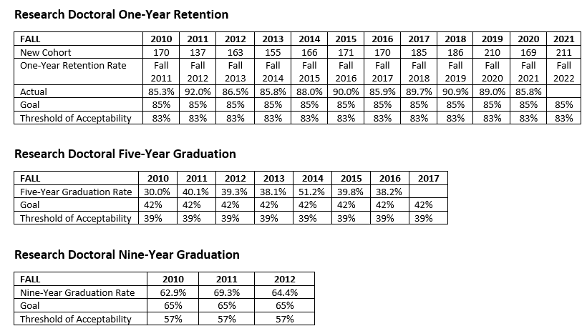
GRADUATE LEVEL RETENTION AND GRADUATION DASHBOARD
https://ir-analytics.charlotte.edu/tableau/graduate-level-retention-and-graduation-dashboard

Slide 26
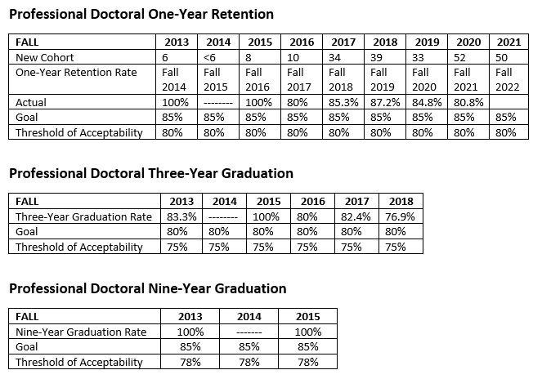
GRADUATE LEVEL RETENTION AND GRADUATION DASHBOARD
https://ir-analytics.charlotte.edu/tableau/graduate-level-retention-and-graduation-dashboard

Slide 27
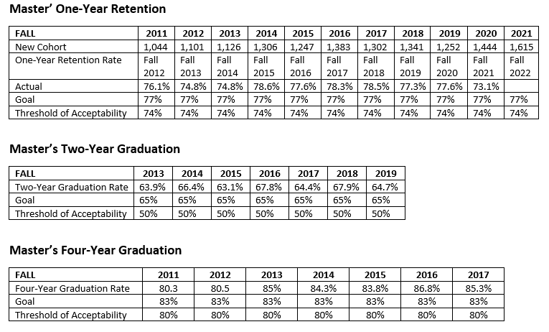
GRADUATE LEVEL RETENTION AND GRADUATION DASHBOARD
https://ir-analytics.charlotte.edu/tableau/graduate-level-retention-and-graduation-dashboard

Slide 28
General Q & A
Notes:
Katherine to ask

