Slide 1
Fall GPD Summit
September 10, 2021

Slide 2
Dean Tom Reynolds
Welcome and Introductions
Overview

Slide 3
Diversity, Equity and Inclusion in Graduate Education
The Graduate School is leading an effort to address equity in graduate education at Charlotte. One part of this effort is to assess our access & success practices in each graduate academic program. Our mission is to ensure that we are being equitable to all who wish to, or already do, participate in graduate education at UNC Charlotte.
The first part of this effort is to understand what efforts are already underway. This should not duplicate work being done in other areas. Rather, we hope collaborate with others to improve success outcomes.
Notes:
MANUEL

Slide 4
Resource: GRAD 6/8xxx Topics on Diversity and Inclusion
Course Description
The objective of this course is to explore diversity and inclusion from various multi-disciplinary perspectives. Diversity is often equated with a disciplinary view rooted in social justice. Yet, over the last few years research in diversity has demonstrated numerous disciplinary-specific points of view. Groups with more diversity perform better than other groups. Companies with a diverse employee base tend to produce better financially. These various discipline-specific findings provide a strong case for why diversity matters. Given the value of diversity, how do we build organizations and systems that are inclusive.
Course Objectives
Having successfully completed this course, students will be able to:
understand the value of a diverse and inclusive organization,
facilitate dialogue about diversity and inclusion,
articulate research and practice in support of diversity and inclusion.
Notes:
MANUEL

Slide 5
Graduate Policy Equity Audit
Charged by Academic Affairs
Susan McCarter
Matt Parrow
Oscar Lansen
Manuel Perez
TBD - Graduate Council rep
Ex Officio - Katherine Hall-Hertel
Ex Officio - Sandy Krause
Ex Officio - Leslie Zenk
GA - Kelcie Grenier
Notes:
Katherine

Slide 6
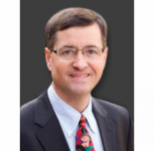
Supporting Students
Graduate Student Ombudsman - Dr. Bruce Taylor
Issues of fairness, process, financial distress, etc.
Confidential, to the extent possible, and objective
By appointment - 704-687-5347
Notes:
Katherine

Slide 7
Supporting Student Success
•New name
•New logo
•New location coming soon!
Notes:
Katherine

Slide 8
Upcoming initiatives
•Accelerate to Industry (A2i)
•The Professional is Personal - CAPS
•Diversity programming
Notes:
Katherine

Slide 9
•Deadline to register is October 18
•Preliminary Rounds are October 19-21
•Final Round is November 12
•Increased prize money
•Each participant will receive a video of
their presentation
•Workshop and kick-off event October 5
Notes:
Katherine

Slide 10
Supporting Student Success
Academic Policy Update: New Grade Mode for continuing master’s and doctoral research
DegreeWorks upgrade
Early Entry updates
Notes:
SANDY AND JANET

Slide 11
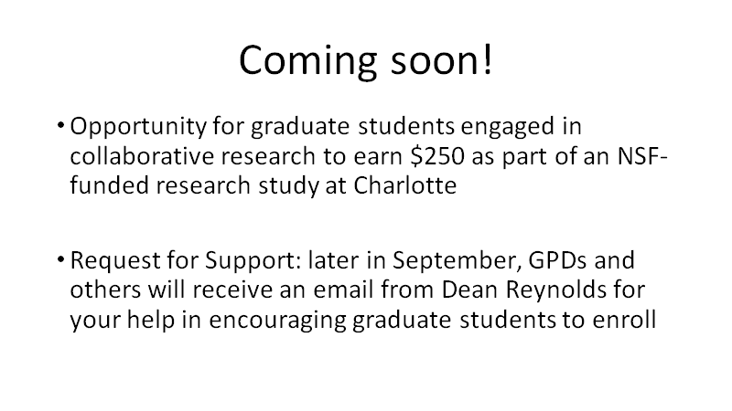
Notes:
LISA

Slide 12
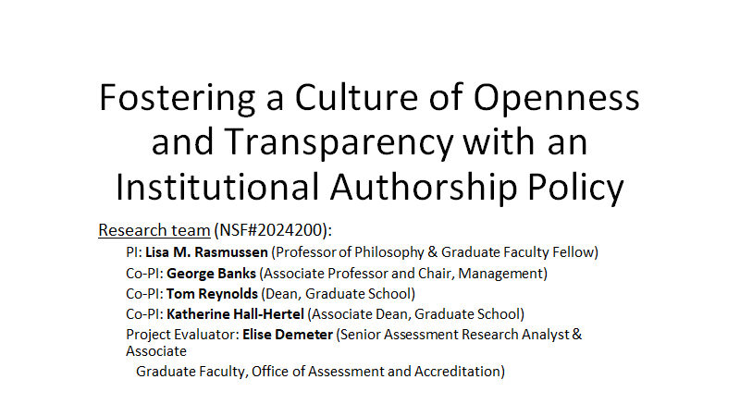
Notes:
LISA

Slide 13
Notes:
LISA

Slide 14
Notes:
LISA

Slide 15
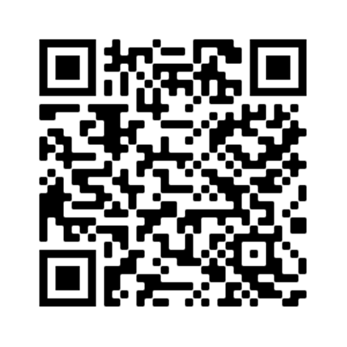
Project Results:
Authorship Policy Review
•“Authorship Policies at U.S. Doctoral Universities: A Review and Recommendations for Future Policies,” Science and Engineering Ethics
•Research question: What is the prevalence and characteristics of authorship policies at US R1 and R2 institutions?
•Main Findings out of 266 total institutions:
•Only 24% (n=64) had a publicly accessible authorship policy
•Only 16% (n=42) have a policy that mentions disputes
•35 of these came from institutions with a medical school (some directly from the medical school)
•7 came from R2 institutions
Notes:
LISA

Slide 16
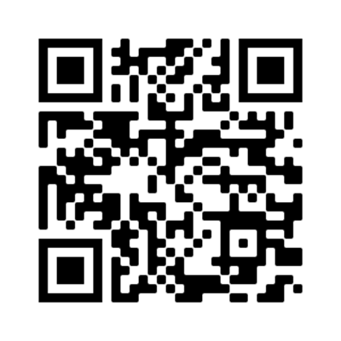
Project Results:
Policy 318:
“Authorship Policy and Resolution Procedures”
https:://legal.charlotte.edu/policies/up-318
Notes:
LISA

Slide 17
•Enroll 6 cohorts of graduate students working on collaborative research (across next six semesters)
•Provide training about authorship standards, possible tensions, and potential solutions
•Support the completion of authorship conversation and agreements between graduate students and faculty mentors
Thanks in advance for your support!
Notes:
LISA

Slide 18
Funding Update
Notes:
JULIE

Slide 19
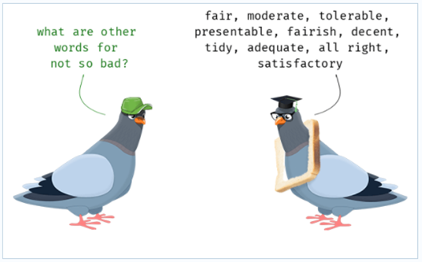
GRAD 9800 Enrollment Helped – Thank you!
•All GASP 5th years were asked to enroll in GRAD 9800
•Students asked for add’l money to pay for courses in the 5th year, and that was okay
•Pushed students to full-time for financial aid, immigration, GASP, and GA eligibility
•Costs 3 hours rather than 9 hours (saved more than $1 million)
•New policy: GASP will pay for up to 72 hours in *four years, then GRAD 9800 in year five
•Important: students need to complete milestones to enroll – dissertation hours, proposal defense, qualifying exam
Notes:
JULIE

Slide 20
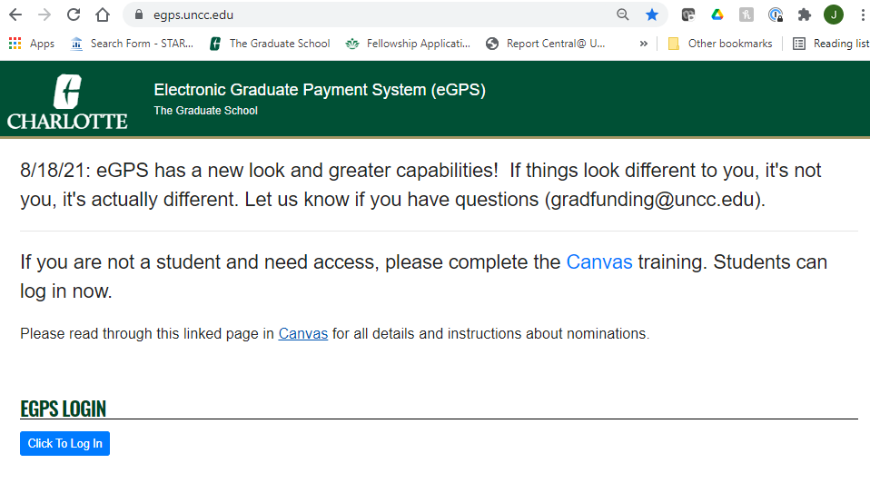
eGPS: It shows you a lot of information!
•https://egps.uncc.edu/
Notes:
Julie

Slide 21
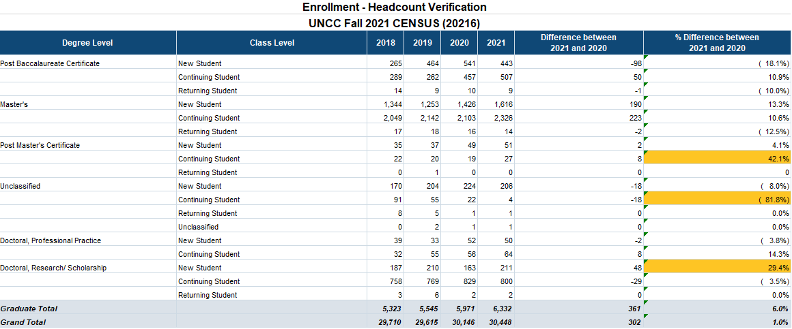
Census Report
Notes:
Maryanne

Slide 22
Holistic Admissions
“Holistic review, or the consideration of a broad range of candidate qualities including “noncognitive” or personal attributes, is a growing strategy for widening the evidence base that graduate programs consider when evaluating a candidate for admission.”
https://cgsnet.org/ckfinder/userfiles/files/CGS_HolisticReview_final_web.pdf
Holistic Review in Graduate Admissions
Council of Graduate Schools
Julia D. Kent and Maureen Terese McCarthy
Notes:
Maryanne

Slide 23
First Principles
Diversity is essential to the overall success of graduate programs. All students in a program, regardless of background, benefit from taking part in a learning environment that reflects various kinds of diversity.
It is critical to think beyond the admissions process when developing strategies for diversity and inclusion. Ideally, recruitment processes, admissions processes, and strategies for supporting student success should be mutually reinforcing.
Holistic review processes are most likely to be successful when well-aligned with a graduate institution’s mission and with the goals of particular master’s, doctoral, and certificate programs.
Notes:
Johnna

Slide 24
Promising Practices
Demonstrate a clear commitment to excellence through diversity in your graduate program.
Gather and analyze department-specific data on graduate admissions. Programs can use these data to:
identify gender- and race-based patterns in admitted and rejected student characteristics.
test whether evidence of student outcomes supports prevailing assumptions about who is likely to succeed (those with a certain GPA or test score, for example).
Notes:
Johnna

Slide 25
Provide faculty members who make admissions decisions with the context needed to evaluate students appropriately.
Provide faculty with information on the appropriate use of the Graduate Record Exam (GRE).
Offer guidance on the optimal sequence for reviewing application materials.
Support communication and alliances between faculty and recruitment officers to ensure admissions and recruitment efforts are well-aligned.
Provide faculty with rubrics for evaluating applicants so that admissions criteria are more transparent and consistently applied.
Consider alternative funding models that might enable new thinking about admissions.
Notes:
Johnna

Slide 26
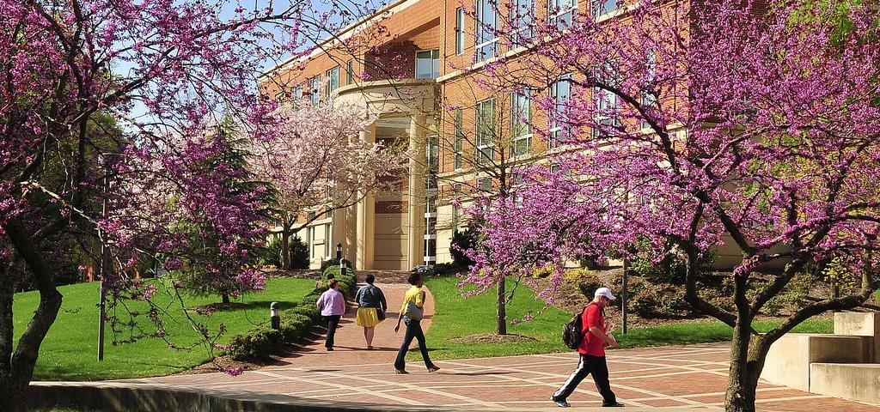
Graduate Admissions System Migration
AdmissionPros to Slate by Technolutions
Notes:
Johnna

Slide 27
Project Goal
Deploy a comprehensive, scalable, integrated and sustainable admissions management system to recruit exemplary students to UNC Charlotte graduate programs.
Notes:
Johnna

Slide 28
Slate by Technolutions
System used by more than 1,400 colleges and universities worldwide, and built exclusively for the unique needs of higher ed.
•Multiple channels of communications
•Dynamic marketing automations
•Unlimited drag and drop forms
•Embedded statistics, visualizations and analytics
•Inbound and outbound communication
•Customized constituent portals
•Simple or complex events
•Appointments and interviews
•Calendar integrations
•Document/file hosting
•Custom applications
•Custom student status portal
•Automated file review process
•Decision release and reply
Notes:
Johnna

Slide 29
Project Deliverables
Prospective applicants (ease of use + targeted communications)
Recommenders (accessible and user-friendly UI)
Faculty (admissions committee review, rubrics, interviews)
Graduate Program Directors (recruitment>admission review>enroll)
Graduate Admissions Staff (customizable + scalable + automated + quick)
Notes:
Johnna

Slide 30
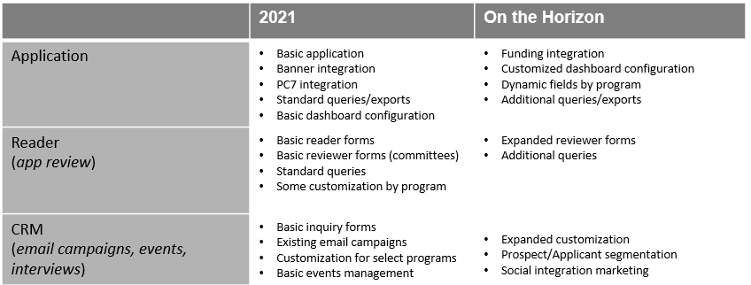
Slate Roadmap
Notes:
Johnna

Slide 31
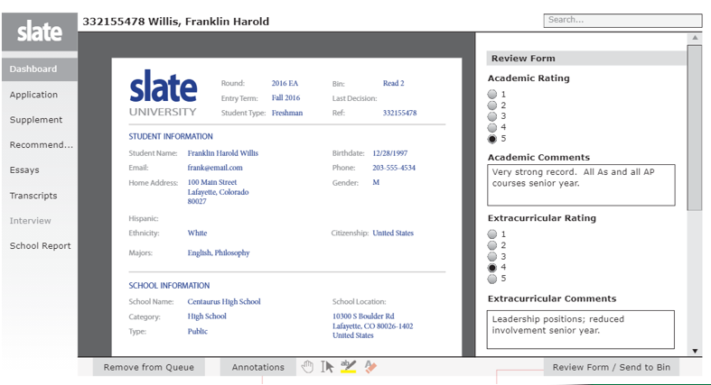
A Sample Record
Notes:
Johnna

Slide 32
“Bins” on the Reader Record
Notes:
Johnna

Slide 33
Recruitment
http://gpdnet.uncc.edu
Notes:
MARYANNE

Slide 34
Q and A
What questions do you have?
Please drop them in the Chat.
Notes:
Johnna

